Slide 1
Lending Club Case Study
- Karan Pandey and Phani

Slide 2
Data understanding
Problem Statement
How data is used to minimise the risk of losing money while lending to customers. The aim is to identify patterns which indicate if a person is likely to default, which may be used for taking actions such as denying the loan, reducing the amount of loan, lending (to risky applicants) at a higher interest rate, etc. The company wants to understand the driving factors (or driver variables) behind loan default, i.e. the variables which are strong indicators of default.

Slide 3
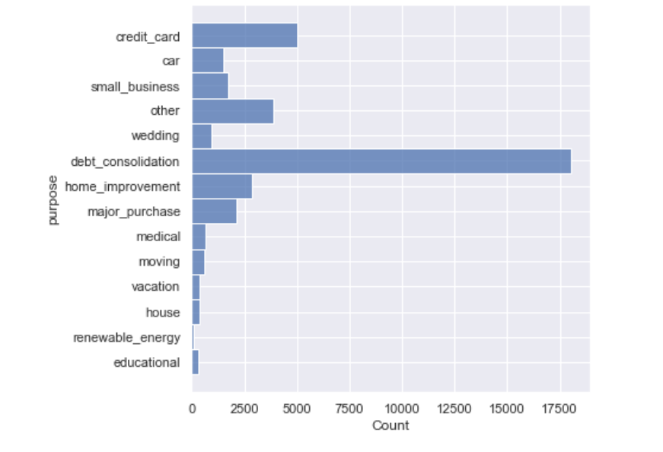
Purpose Column (Charged off)

Slide 4
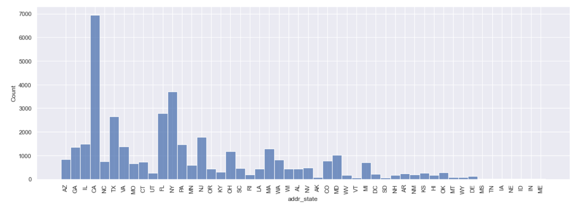
Addr_State (Charged off)

Slide 5
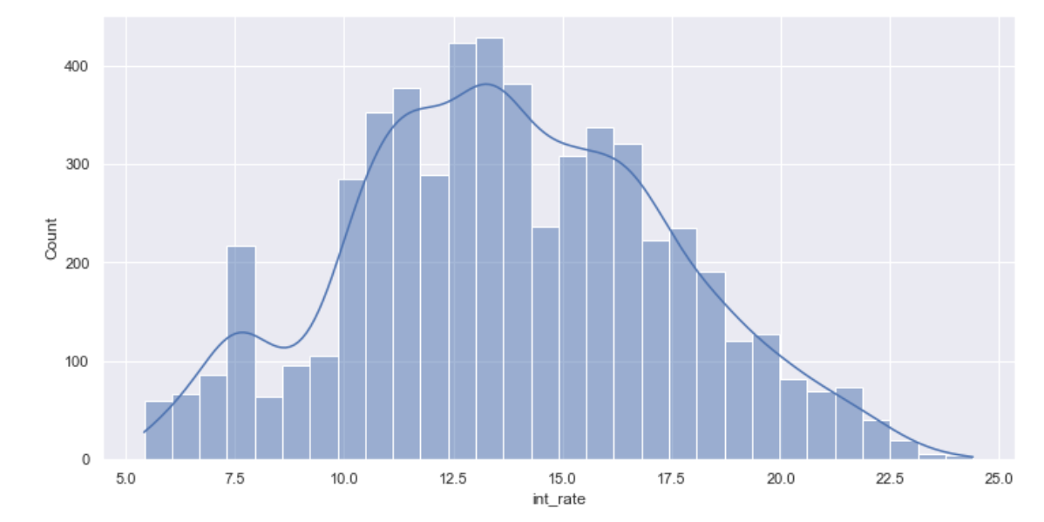
Int_Rate (Charged off)

Slide 6
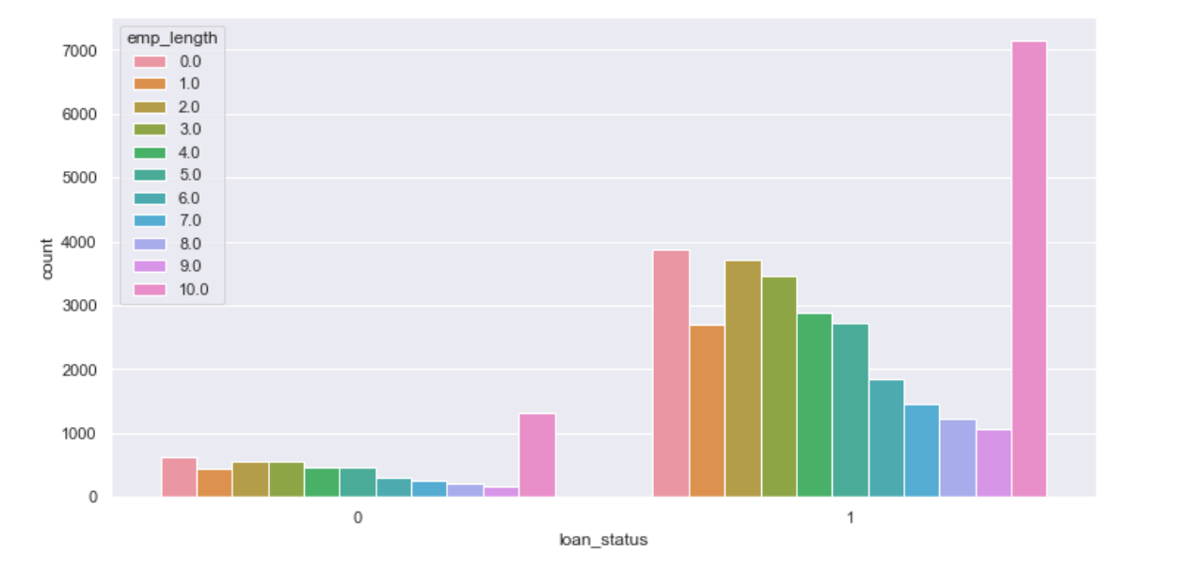
Emp_length

Slide 7
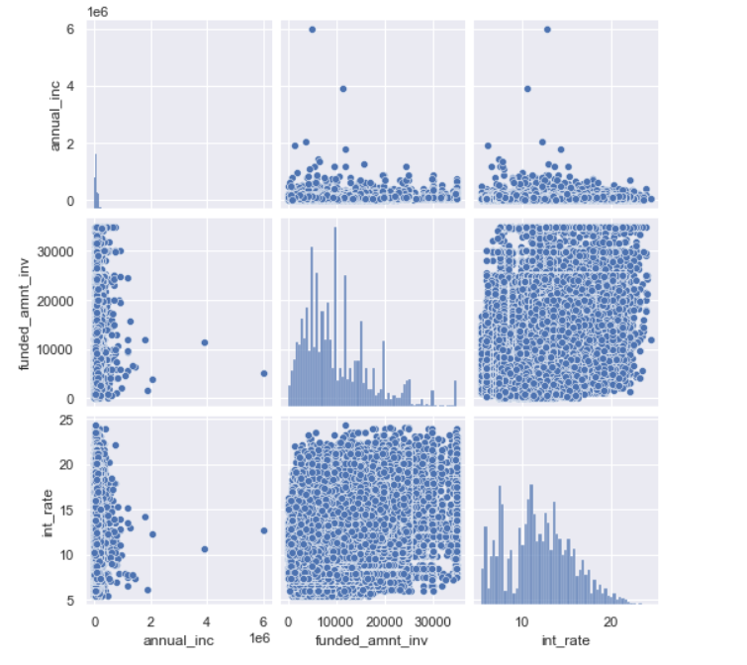
Bivariant analysis

Slide 8
Observation
Most of the loan that has been charged off has purpose debt_consolidation
Most of the loan with int_rate being high has been charged off
Most the charged off customer are from CA.

Slide 9
Recommendation
Bank can strong the verification for loans taken for debt_consolidation
Bank can think on the interest rate, not to make it too high customer fails to pay.
Bank can strong the verification for CA. Some extra documents can be asked.

